Slide 1
A level Computer Science
Trip Planner Program

Slide 2
Outline
The aim of this guide is to show pupils how they might go around structuring their A level Computing coursework. This follows the guidelines set out by the OCR board but this could be used to support the requirements of most examination boards. I have attempted to create a program project for a trip planning program which is based on a scenario at a school where I currently work the Royal Grammar School in High Wycombe. The program was complete but the write up was not I have attempted to indicate here where the write up needs to be completed and given ideas for how to improve the documentation and program

Slide 3
Set Task
The Royal Grammar School runs a number of trips each year for boys going overseas and in the United Kingdom. Some of these are organised through World Challenge a local company which specialises in providing educational trips. Some of the provisions and supplies for the trips have to be ordered in advance and prior to departure of the trip owing to the availability or in some cases cost of buying provisions in the country. Create a program that will store and produce a list of the quantities of food and equipment required for each trip.
The program should ask the user to input:
The destination of the trip for example (Croatia, Jordan, Iceland, Mali)
• The number of boys that are going to go on the trip
• A list of food provisions and equipment that might be required including individual items, quantities required and the units that they come in Oats so simple 90 sachets
The date of departure for the trip
The date of return
The program should store the trip destination, number of boys and equipment provisions with their quantities and units. The user should be able to retrieve the trip details including the information and where appropriate revised quantities if the number of boys going on the trip changes.

Slide 4
Set Task
Tasks
Write down a list of suitable objectives that you would expect this program to perform. Remember these are important as these are going to be the success criteria that will used to judge the success of the program and will need to appear throughout program documentation in design, development and testing
Write out an algorithm for the following parts of the program
Add a new trip
Add a list of provisions to the trip
Edit a trip details
Search for a trip details
Produce a list of output for the trip
Allow the user to alter the number of boys going on the trip to produce an amended list showing the new provision
Design the user interface for the program – what will be the main objects that are going to appear on the screen
Write out a description of the variables, lists and records that you are going to use in the program
Document a test plan for the trip planner program. There needs to be a minimum of 10 tests and you must include examples of validation in the program.
Produce a detailed guide showing the development of the program stating / explaining the main
Produce a comprehensive testing section showing how you have met the objectives stated at the start
Write an evaluation of your solutions identifying the tools that you have used to make this an efficient solution and how you have met the objectives.

Slide 5
Outline
I am going to show as far as possible 2 methods for solving this problem one is done using a flat file approach the other which you will have to use for you A level project will involve using a relational database. The idea of this tutorial is to give you an idea of the approach needed when writing a project at A level, what needs to be included in your documentation in terms of each of the sections, and programming techniques that have been used. It will be realistic in terms of its evaluation of techniques used here and what you could do to improve the approach to gain an overall better grade. The trip planning project idea in itself as set out here is not likely to be sufficient to gain the top grades with the new reformed A level. There would not be enough in terms of computational processing taking place within the program. Owing to the limitations of time not all of the features have been fully developed. I have tried in this example to give a lot of indication as to how this idea can be developed

Slide 6
Approaching the Analysis Trip Planning Project Problem identification
(a) Describe and justify the features that make the problem solvable by computational methods. Prove that the output that is required, e.g. a prefect rota, a receipt or a game win can be achieved with a list of known inputs and formulas, show that any additional complexity/variables/precision, etc will not affect the output that much/customer is not bothered about that extra stuff.
With the trip planning example given, the program is performing 2 sets of calculations, based on the changes to the dates and the number of boys going on the trip. The program will calculate the individual number of units for each item and produce a total at the end.
To make this more suitable for an A level project
The program could be extended further to give costings broken down. Usually each trip will be assigned a budget, so the program could be modified to include other details including
Cost per unit of product whether this by the tin, packet, gram, sachet
The nutritional value of each of the provisions that have been included in the overall main list of provisions.
Could the program be modified to model based on the budget given the best value for money the highest amount of provisions that can be taken given the budget outputting the best nutritional value. This would involve collecting and inputting more data about the provisions themselves including calories, fat and other values as well as costs per packet, sachet, tin, grams whatever. In your write up in addition to completing the base tasks you would need to address how your program could achieve this. Can you use the graph plotting and modelling library to solve this problem

Slide 7
Approaching the Analysis Trip Planning Project Problem identification
(b) Explain why the problem is amenable to a computational approach. Why using your platform the best way of solving this problem, why not do it with pen, paper or a calculator
For this part you need to think about all of the reasons why the solutions you are looking for are best solved using a computational approach. Assuming you if you were doing this for real and incorporate the ideas on the previously slide then the program could be developed to work out the best combination for nutritional value based on the budget available. You would need to work out the best possible combination perhaps based on the types of activities that the boys on the trip are going to be engaged on. For example the Norway expedition may involve carrying packs of up to 50 - 60lbs and walking 10-15 miles each day in mountainous areas. Can you develop the program further so that it could work out the most efficient combination of foods that give the most calories, energy whilst staying in the budget. Clearly if you were to use a calculator it would take a long time. With the fact that the provision quantities can be altered makes it far easier for the program to be used as a model which can be changed and reused. Reports and graphs can be saved and wood be available for re-use. Dates can be changed and altered . To make this work and extend it further you would need to look and gather nutritional values for provisions as well as prices. Are there substitutes can anything else be added? How can the data be presented as a graph, as output to the screen or in a printed form?

Slide 8
Approaching the Analysis Trip Planning Project Stakeholders
(a) Identify and describe those who will have an interest in the solution explaining how the solution is appropriate to their needs (this may be named individuals, groups or persona that describes the target end user). | Who will be approving your success criteria and not paying you money if enough of them are not met. What is their name? Are they a company? How many people work at that organisation? Have they been growing? Is this program going to help them change/grow their business/function How are you going to research their needs?
If we going to take this project on then it would be organised for the school and used by teachers taking boys out on world challenge type expeditions. You would have to explain the scenario here, provisions need to be taken overseas as often it is cheaper and more affordable to buy resources prior to departure rather than purchasing provisions in country especially when you consider some of the locations that the boys at RGS go to, Mongolia, Tanzania, Peru and Vietnam. Here you would need a description of how this program is going to be used, who will use and what information is going to be needed/

Slide 9
Approaching the Analysis Trip Planning Project Research the problem
(a) Research the problem and solutions to similar problems to identify and justify suitable approaches to a solution. Have you looked at the competition and commented on the good and bad features of each? E.g. 3-4 different versions of Snake. What is in common and what is different between these solutions? What can your program offer that competition can't?
For our purposes here for this project there may not be alot of alternatives out there on the market. This is not going to be a program likely to draw any meaningful competition from companies. We are doing to solve a specific problem related to the organisation and provisions at our school. You should research to see if there is anything available, in this context our solution may prove to be the best on the market.
For other A level projects this is an important part of the process in reality this will involve discussing whether you can buy a product off the shelf or whether we have to produce a tailor made solution.

Slide 10
Approaching the Analysis Trip Planning Project Research the problem
(b) Describe the essential features of a computational solution explaining these choices. Having done your review of existing products, what ideas would you take on board, justify with an example of something more your customer can achieve with this feature.
(c) Explain the limitations of the proposed solution. Given the time you have had and your level of skills (as well as the limitations of the customer), which great ideas/features would you NOT be able to implement? This will connect to evaluation later on, where you will justify why it might be worth adding later.
To get into the top mark band grades using the trip planner I have suggested that you might want to use some kind of modelling. At a more micro level you could consider so further constraints for example how many of the boys in this instance have special dietary requirements which may affect the combinations of provisions and their quantities. This would require further research and adding further parameters into your program

Slide 11
Approaching the Analysis Trip Planning Project Specify the proposed solution
(a) Specify and justify the solution requirements including hardware and software configuration (if appropriate). Provide hardware and software requirements, e.g. administrative access to registry, internet connection. Some of your tests later on will include running your program on the computers of different spec and noting the difference in time it took to do a task, e.g. searching or writing to disk.
You should be willing to give a detailed description of hardware and software. It is unlikely that the program is going to require a lot of storage space, although it may require a lot of processing power to work out some of the calculations required

Slide 12
Approaching the Analysis Trip Planning Project Specify the proposed solution
(b) Identify and justify measurable success criteria for the proposed solution. A table of 60+ objectives (split into usability, performance, reliability (validation), and maintainability (how easy to change the code later or add new features) and how you intend to prove you will have met these objectives.
Logon
It is essential that your program has at least 60 objectives. This should also include the ability for a user to log on and validate their user name and password. Each teacher could have a log on and be assigned to a particular trip and can view and edit data relating to that trip but no others. There should also be an administration option where one user has admin.
I have not done a user log on account but have a tutorial relating to this.
Objectives here for a log on could include
Usernames could be an email, and therefore would have to have the characteristics of an email address.
Passwords have to be a certain length with a number of upper, lower and numerical characters. Can the password be encrypted?

Slide 13
Approaching the Analysis Trip Planning Project Specify the proposed solution
(b) Identify and justify measurable success criteria for the proposed solution. A table of 60+ objectives (split into usability, performance, reliability (validation), and maintainability (how easy to change the code later or add new features) and how you intend to prove you will have met these objectives.
Addition of new Trips and Provisions
Enter new trips from a pre-specified list of countries loaded into a list
Allow the user to enter the number of boys going on the trip, must be an integer, larger than 3 and less than 25. The user is given the option of allowing more boys to go on the trip
Allow the user to enter the dates of departure and return. The dates entered cannot be in the past, and the date of return must be after the date of departure.
The program calculates the number of days that the trip is running based on subtracting the Date of return from the date of departure
This data is stored in a database file.
The program should allow the user to enter provisions for the stated trip. The user should be able to enter the quantity required and this has to be greater than 0 and an integer or a float / real number.
The program should alert the user if there is trip going to the same place in the same time frame

Slide 14
Approaching the Analysis Trip Planning Project Specify the proposed solution
(b) Identify and justify measurable success criteria for the proposed solution. A table of 60+ objectives (split into usability, performance, reliability (validation), and maintainability (how easy to change the code later or add new features) and how you intend to prove you will have met these objectives.
Addition of new provisions
Enter new provisions to be added including their provision id, provision name and units of measurement
Allow the user to edit these provisions and change the units or spelling
Allow the user to delete the provisions if these are no longer required and these are deleted across the database entire
Search for Trips and provisions
The program should display the details of all trips planned including trip id, destination, number of boys as well as dates of departure and return as well as the days that the trip is running
When the trip is selected the program should display the provisions selected for the trip including provision id, provision name, units and quantities selected
The program should allow the dates of departure and return to be amended and should recalculate the quantity of provisions required for the trip
The program should allow the user to modify the number of boys going on the trip this has to be an integer, greater than 0 and less than 25. The program should recalculate the quantity of provisions required for the trip based on the new number of boys going on the trip

Slide 15
Approaching the Analysis Trip Planning Project Specify the proposed solution
The program should calculate the total number of units for each provision for example the number of tins, jars, sachets, pieces, grams, etc required
Any changes made to the number of boys or dates should be written to the database
The program should produce printed output which gives a break down of provisions required for each trip
The program should be able to graph the quantities of provisions required with the provision name appearing on the x axis

Slide 16
Approaching the Analysis Trip Planning Project Specify the proposed solution
Additional objectives
The program should be capable of storing the details of the costs, and calories in each provision unit
The program should allow the user to enter a budget figure for the trip
The program should be capable of calculating the calorie
You may want to consider the following
On an expedition each boy will need 2500 - 3000 calories per day
The weight of the food for example potatoes are quite heavy
The composition of food requirements should be
Carbohydrates 60-65%
Fats 25-30%
Protein 10-15%
What combinations of these stay within these limits whilst keeping to a tight budget
Thee are the additional objectives which you should aim to complete in order complete the computational aspects of the project

Slide 17
Design of the solution - Decompose the problem
(a) Break down the problem into smaller parts suitable for computational solutions justifying any decisions made. Create a schedule of which parts of the program will be done in what order, e.g. database setup first, text interface second, login/out, all the searching, deletion, sorting, GUI , validation, etc.
Here you have to shown how the entire problem is going to be broken down into its components parts. So with the trip planner program the first task is log on system -
setting up the database as well as the entities and attributes that go along with it
you are going to include here initial designs and layouts of the forms and prototypes
for each of the screens
Logon
MainMenu
Add A Trip
Search for a trip
Add New provisions
Add /Edit new provisions
you should explain the tasks involved what searching / sorting is taking place as well as creating, reading, updating and deletion that is going on.

Slide 18
Design of the solution - Decompose the problem
Each part should have pseudocode/flowchart no longer than a page - if it is longer - break it down into smaller parts. Good rule of thumb - one procedure/method at a time, one file/table at a time.
For each of the windows / modules / procedures / methods you have to write out an algorithm in pseudocode
Logon - here the input would user name and password - you would need to have a facility for signing up here which would need to allocate an id. The user would be asked for a user name and password on signup - is this going to be hashed in which case what hashing mechanism are you going to use
Then to log in - username - how will this be decided if email is used does the user name entered match the rules for an email address?
Password check that something is entered that the password is matched with the one held on disc. If hashing is used how this converted to the Hash address
If the user can log on what view will they have of the database- if you want to extend this further can you allocate different teachers or members of staff going on trips
If they are an admin user what can they do?
What happens if they are unsuccessful in their log on attempts will the program allow the user a fixed number of times to log in / out

Slide 19
Design of the solution - Decompose the problem
Each part should have pseudocode/flowchart no longer than a page - if it is longer - break it down into smaller parts. Good rule of thumb - one procedure/method at a time, one file/table at a time.
There are 5 screens associated with this program, the plans for these and screen designs will need to be submitted later
Main Menu - screen options are changed when the buttons are pressed, the input here will be when the relevant menu option is clicked which will close one screen and open another.
Add A Trip - Here the user has to select a destination from the list of countries.
input the number of boys validated for type check (integer) and range between 3 and 25 giving the user the option for more boys as appropriate
Select Dates - Departure and Return validation that the dates are in the future
the program also calculates the days
How will the program calculate and work this out?
Add / Edit Provisions - The trip and provision details are read from the disc and displayed you will need to write an algorithm for this is going to be achieved
In this the user must be able to select the provision details and enter the quantity required with the validation required namely number and over 0
The list is sorted when it is displayed in the table how using pseudocode will this happen?
The user has the option to remove items from the provisions or add items to the provisions list before the details of this transaction are written back to the database
The program should also give the option of adding new provisions – checking to see if provisions have been used before. The program should also delete provisions that are no longer required

Slide 20
Design of the solution - Decompose the problem
Each part should have pseudocode/flowchart no longer than a page - if it is longer - break it down into smaller parts. Good rule of thumb - one procedure/method at a time, one file/table at a time.
Search for a trip it is on this screen that all of the real processing of the program is going to take place
The program must be able to display all of the trips in a table when the trip is selected the program then displays all of the provisions that have been entered for that trip.
The user should have the option to alter and change the dates of departure and return and output the days. This is subject to the validation rules set.
The user should have the option to alter and change the number of boys
The program should then calculate the new provision quantities, this has been done taking the original provision quantity multiplying this by the new days or number of boys figure and dividing by the original. This data is written back to the database
The program calculates the number of units of each product, tins, grams, sachets, packets, pieces, jars etc
The program will then output a complete listing of all provisions and totals
The program will then graph the new provisions quantities as a bar graph

Slide 21
Design of the solution Describe the solution
(a) Explain and justify the structure of the solution. List all algorithms you will use. E.g. searching a 2d list, shortest path algorithm, collision detection for Snake. Use UML diagrams here.
Here it is going to be important to describe the techniques that you will use for example when data is read off using SQL then the data is in the form of a tuple this needs to be converted into a 2d list and then read into the table display on the screens what techniques are to employ to do this?
What sorting and searching methods will be used to sort the lists
You are expected to draw and use UML diagram which is a class diagram describes the structure of a system by showing the system's classes, their attributes, operations (or methods), and the relationships among objects.
For your A level project shortest path algorithm could be used for route planning, for games you may have to specify collisions

Slide 22
Design of the solution Describe the solution
(b) Describe the parts of the solution using algorithms justifying how these algorithms form a complete solution to the problem. Pseudocode/flowchart for all operations. If similar code in different parts of the solution - can link to the same pseudocode. If using OOP, use special OOP pseudocode for at least parts of your solution.
You are expected to use OOP as part of the program solution in which case you are expected to use the pseudocode for OOP refers to the parent and child class and interactions between them what part are passed on by inheritance. You will need to include here a detailed description of the attributes, methods and functions used

Slide 23
Design of the solution Describe the solution
(c) Describe usability features to be included in the solution. Design all inputs and outputs (including GUI and paper output) of the program, justify your choice of colours, fonts, themes, widgets.
For each of the screens you are going to design you will need to detail the appearance of the screen, where the buttons are going appear what they are going to do, the font size used, and the colour scheme, Does the colour scheme match any cooperate house style. Each of the screens need a full explanation of how the widgets developed with the PyQT interface are going to work. You should also include a mock up of the input screens.
For output you need to include a plan of any printed or screen based output in the form of a report. How is the report going to be produced, how will it be organised?
In my program I have used a graph I would be expected to detail and plan the output and appearance of any graph that I am going to produce

Slide 24
Design of the solution Describe the solution
(d) Identify key variables / data structures / classes justifying choices and any necessary validation. Tables of variables, lists, GUI widgets SQL tables: names, data types, sample data, any constraints (validation rules)
UML diagram of classes
Here you are going to need a complete data dictionary of all of the
Database entitles and attribute used together with validation which are primary and foreign keys
You need to include an entity relationships diagrams here which is going to detail the links between all of the entities and attributes this has to include SQL tables and examples of data and constraints
Class structures methods, attributes used
Lists used and description of purposes and data held

Slide 25
Design of the solution Describe the approach to testing
Identify the test data to be used during the iterative development and post development phases and justify the choice of this test data. Test plan: what will be tested when.
Testing consists of 2 parts the systematic testing that appears later in the presentation the idea of testing as you are going along and post development functional testing.
The final testing needs to be related to the objectives and include examples of extreme, normal and valid data these are program related testing
You also need up success criteria for the program speed of response, program not crashing if buttons are pressed, data being refreshed and update and access times.
GUI tested for being able to get back, not crashing if buttons are pressed too fast, etc.
Every success criteria will have its own test, or even multiple tests (e.g. for normal, extreme and invalid data),
What can you test before the program is complete and can't?

Slide 26
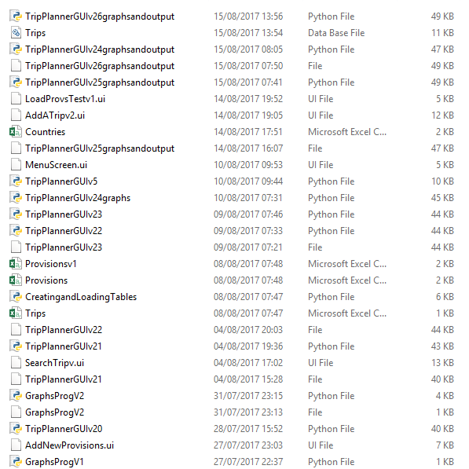
Developing the solution Iterative development process
(a) Provide annotated evidence of each stage of the iterative development process justifying any decision made. Evidence that finished code doesn't just magically appear out of nothing - first, there is a simple bit of code, which then gets wrapped in a procedure, then gets assigned to a class, then validation, etc. screenshots throughout the way before and after screenshots for major changes
You are expected here to show the story of development and not just show the completed program - how did this develop. I am including a screenshot to show how my program developed starting with the main menu screen, add trips, add provisions and then searching. During the process I created over 50 program prototypes and have example of where programs reached certain stages and then I moved on. I should show along the way how these developed including changes to the interface. For example on the add a trip screen I changed the input for destination from a text box to a combo box so the chance of entries and countries is restricted

Slide 27
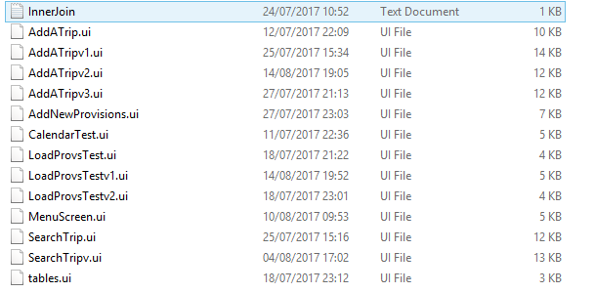
Development of the solution Describe the solution
(b) Provide annotated evidence of prototype solutions justifying any decision made. All dead ends or multiple approaches from which you chose one - why + screenshots of each.
Here you have to show the approaches you made while developing the program. The shows all of the screens I have created since I started with the development of the program. For add a trip I have created 4 different screens in my commentary I would need to reference the changes to the program I have made. In my search screen I have added a tabulated section to give the user more options. The development to this part of the process needs to be documented.

Slide 28
Development of the solution testing to inform development
(a) Provide annotated evidence for testing at each stage justifying the reason for the test. Code changes after testing, way before the program or even the module are finished. Procedures are first tested by themselves with hardcoded (no user input) input values, only then integrated into the main code.
I have kept previous programs that I have created, in my documentation it is a good idea that I show the mistakes I made and the help I sought to overcome those mistakes. For this program I had to experiment with all of PyQT's widgets and to practice for example getting data to be displayed in the table widget. I should also show development in relation to the use of the matplotlib library.

Slide 29
Development of the solution testing to inform development
(a) Provide annotated evidence for testing at each stage justifying the reason for the test. Code changes after testing, way before the program or even the module are finished. Procedures are first tested by themselves with hardcoded (no user input) input values, only then integrated into the main code.
I have to show how I have used each of the following features
Relational database of at least 3 tables.
Inheritance
Hungarian notation
Regular expressions
Multiple inheritance
Debugging mode when program outputs what procedure is running and values of variables which get saved to disk file.
Shortest path algorithm
Polymorphism
For failed tests, use errors and text boxes to show the error and how it was fixed. What was your thought process that helped you find the mistake and fix it.
Using one of: debugger, variable watch, breakpoints
Comments for every loop, selection or procedure
Parameter passing
Presence and data type check contained in reusable procedures
Mix of functions and procedures (or methods that return and don't return values)
Variables of different scopes: class, object, local, global
Use of constants with capitalised names
Use of modules imported as needed.
Log in and out with hashed password data
Two types of user accounts: admin and regular. Admin can do things to regular accounts.
Passwords checked for strength.
Sql parameter queries (with question marks)
Inner join or nested sql queries

Slide 30
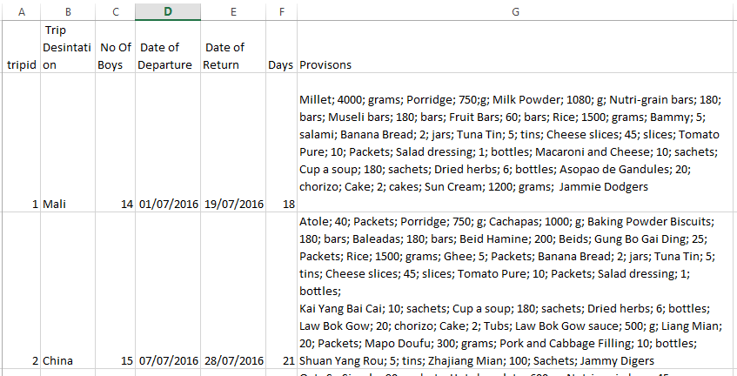
Development – Flat File
This shows the data structure I am going to use

Slide 31
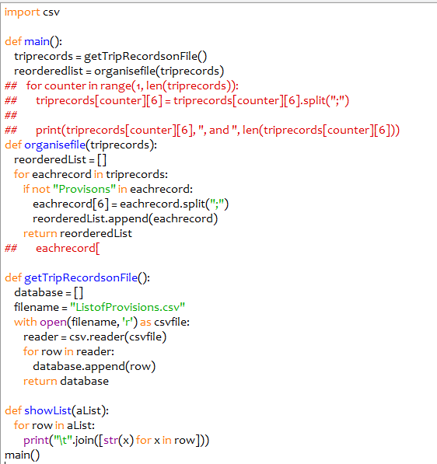
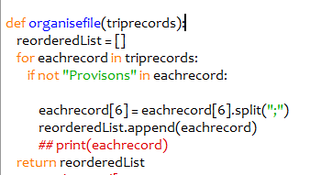
Reading in from a spreadsheet aka CSV
In a number of scenarios you will or may be required to read in data off of a spreadsheet with the data being saved in a csv format. This is the working code which reads in the data highlighted earlier and places this into a list. The data is read in to start off with into a list called trip records and then the provisions part which appears in the sixth column of the file is then further segregated into another list

Slide 32
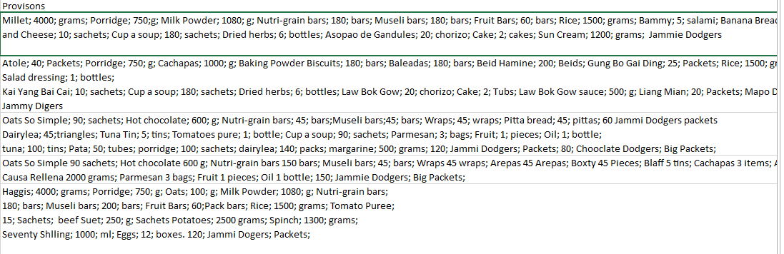
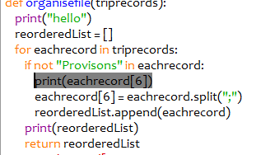
Creating a flat file database
This is the list of provisions which appears in the 6th column. This function separates those items of data into a list in their own right,,

Slide 33
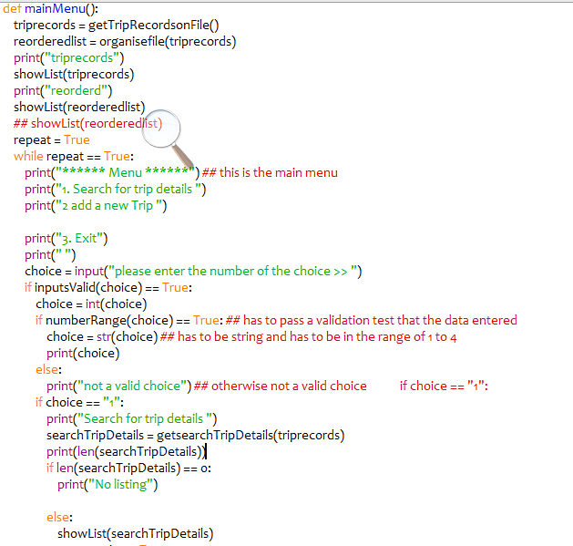
Using a menu system
This is main menu part of the progam where the user is given the option to search for trip or add a new trip details.
There is some validation performed to ensure that the menu options entered are integers and are within a valid range. Only if the details of the trip and details being searched for are found will the program allow any recalculations to take place

Slide 34
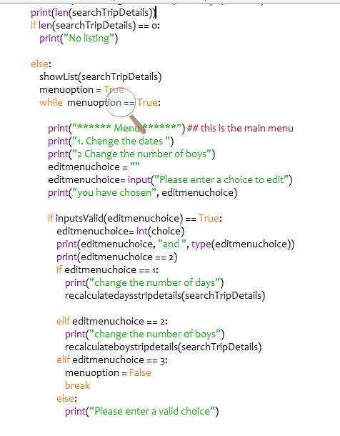
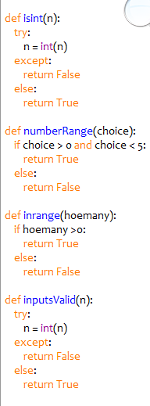
These options are giving the user the chance to change the number of boys or to edit the number of days that the trip is going to run for. By changing any of these changes the quantity of provisions that are then written back to the database
This code represents the validation we have used and gone through in the past, whether this is for checking the data entered is an integer or if this within a certain range

Slide 35
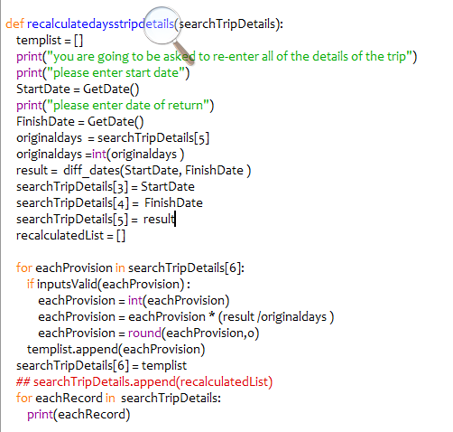
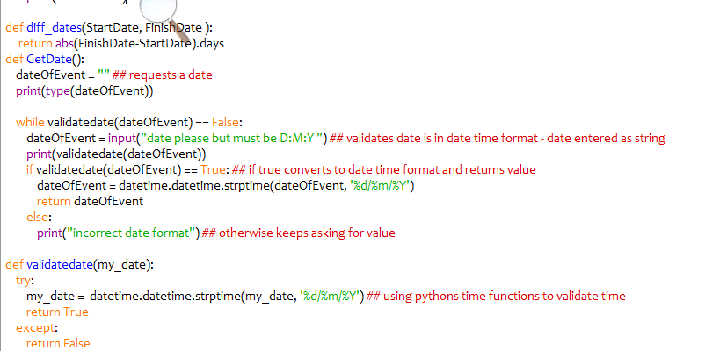
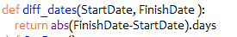
Days Calculation
This function asks the user for the new dates for departure and arrival. The original calculation was based on the dates given so we need to work to work out the number of days and then base the recalculation on this. in order for these to be recalculated. The program is validated so the date is validate for the start and end dates to be of date time data type.
We are using one of Python Library's function to work out the difference between each of the dates

Slide 36
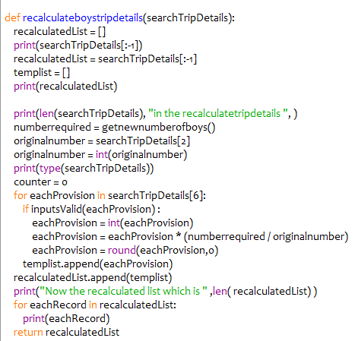
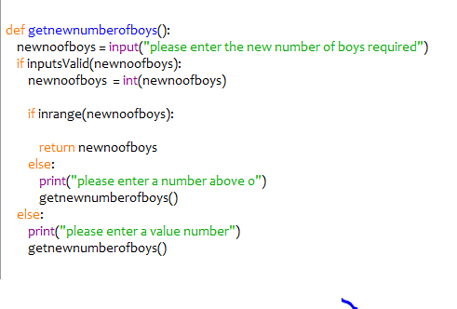
Check the number of boys on the trip
This is based off of the search list results. The program has to check that each item in the list is a number and only if it is does it complete the required recalculation. The markers in eachProvision 6 are denoted by “,” as these are comma separated value. This particular part of the function has to check to see if each individual element of the list is an integer value and if it is then that number is multiplied by the new number required and divided by the original. This is appended to a new list and the results displayed at the end. The new data could be written to a file

Slide 37
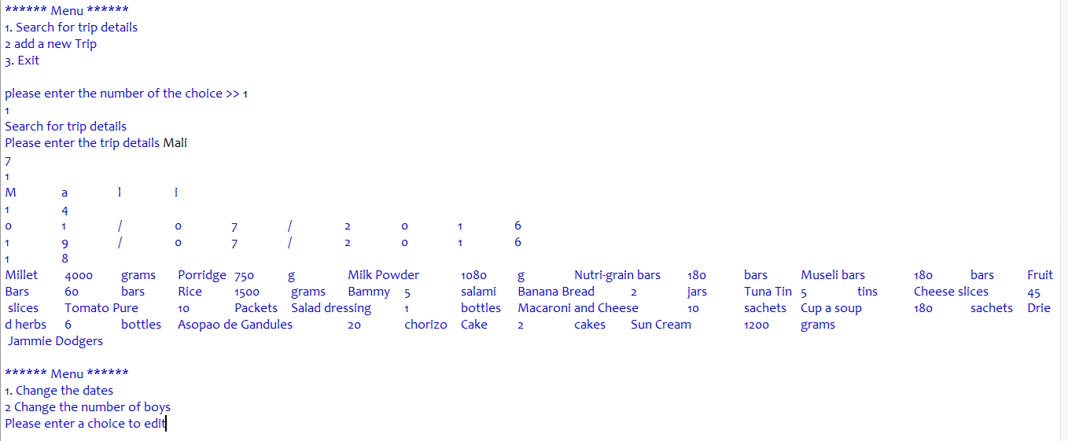
Program running
I have selected the option for Mali. I am going to change the number of boys and days

Slide 38
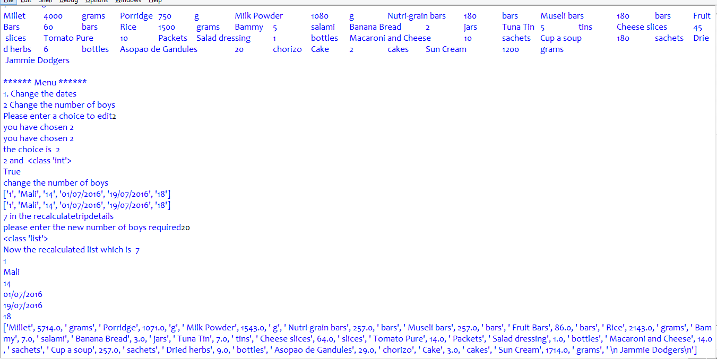
Number of boys
Here I have changed the number of boys to 20

Slide 39
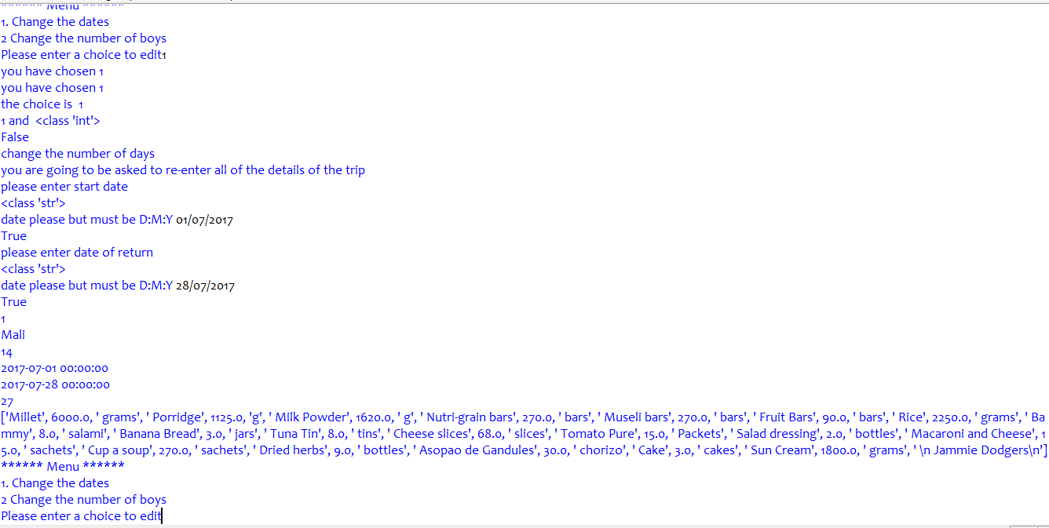
Number of Days
I have changed the original dates for this to make it 27 Days

Slide 40
Evaulation
The aim of this was to show of the basic functionality involving a flat file, the program fulfils the requirements of the set task and is a good standard to be aiming at for GCSE. The program has the ability to read off a file and search for a file. The program would need the add feature to be added so that the user can enter new trip details, number of boys, the dates of departure and return

Slide 41
Relational Solution
Trip Planner Program

Slide 42
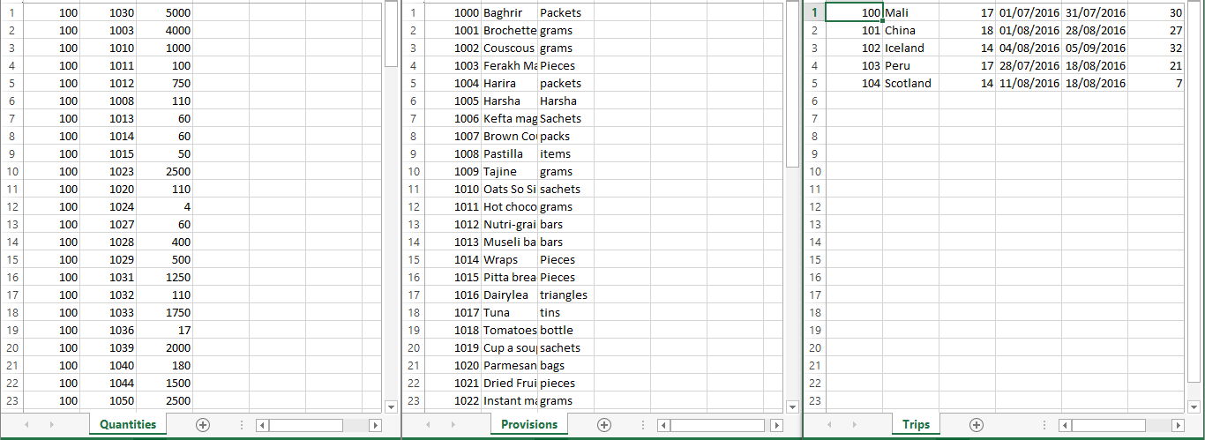
Introduction
Here we are going to create 3 entities aka tables which are going to contain all of the trip details, provisions and quantities which are going to be used on each trip. These have been re-organised so that they are in 3 tables. The tables are also in a normalised format

Slide 43
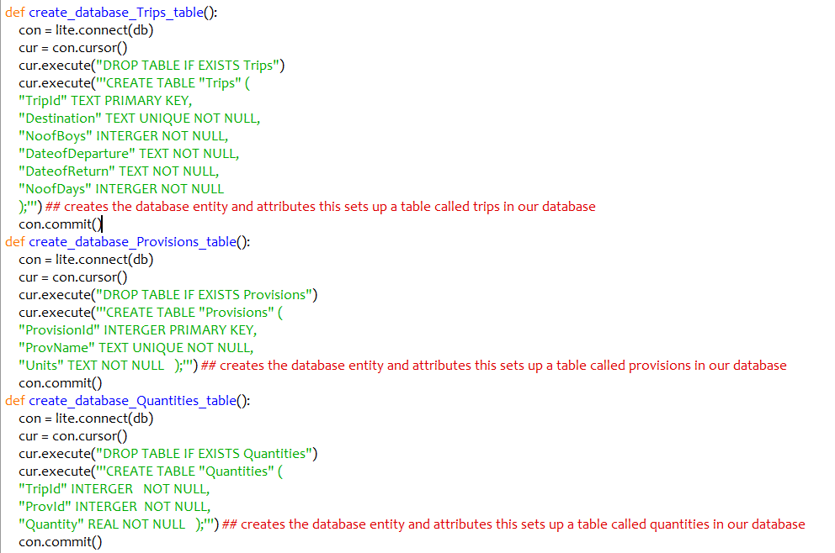
Creating the database files
Each of these functions creates an entity which is going to appear in the database. Each entity has a primary key and secondary keys with data types. The table of quantities has 2 foreign keys TripId from the Trips table, provisionsid from the provisions table and the amount required for each provision entered

Slide 44
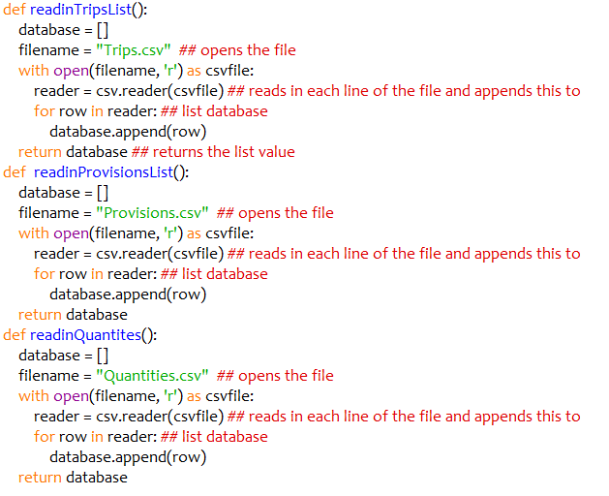
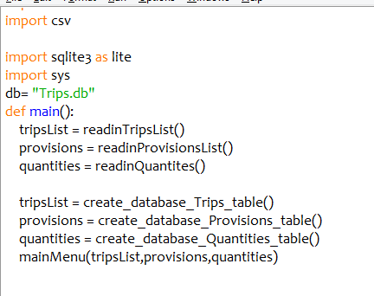
This simply reads in the data from the 3 CSV files into the database
Main is called when the program is initialised. The database is loaded and the data is read in.

Slide 45
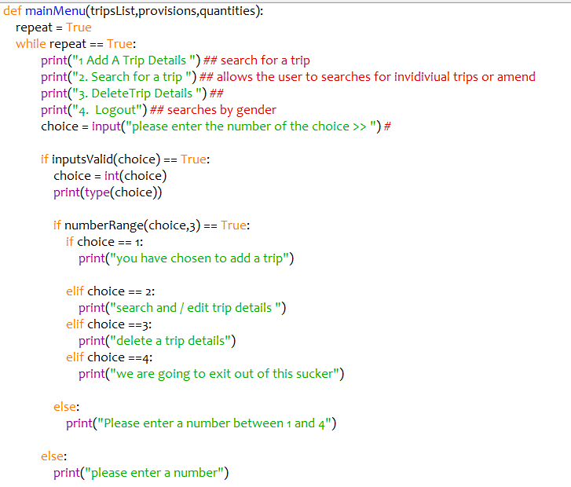
This is going to remain a work in progress and shows how I am going to develop my menu structure at the moment this does nothing excepts validates the menu structure. This will be developed further and will involve a user interface

Slide 46
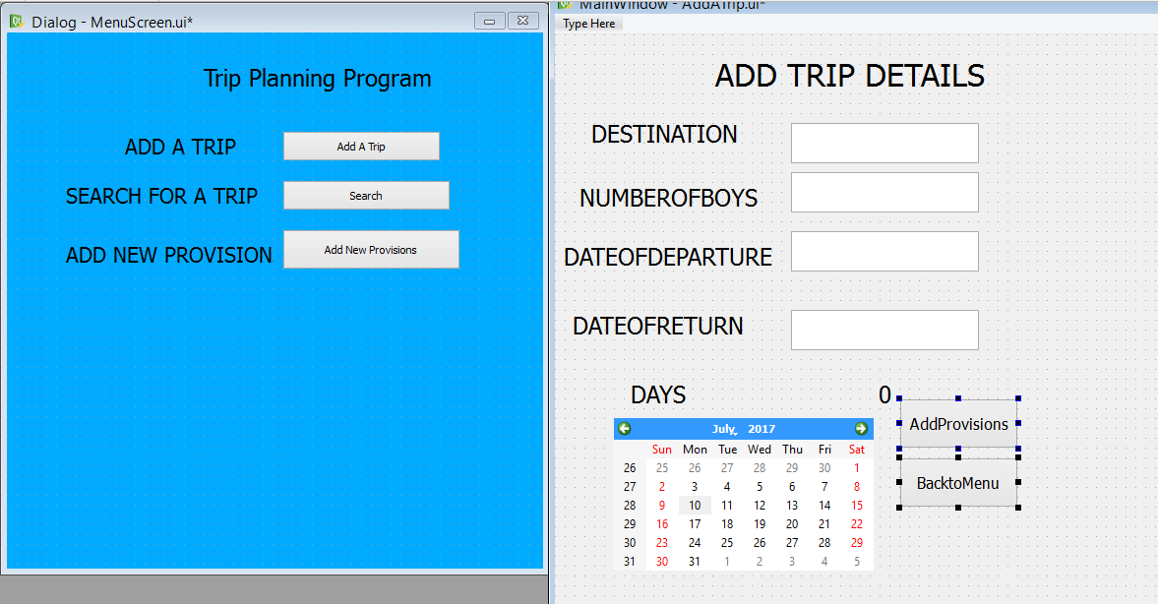
Creating the user interface
I have created 2 simple forms one is the main menu which initialises when the program is opens and the other form to add trip details. I have installed a number of widgets here so destination details. I have used a calendar widget so that the user can enter dates of departure and return. The program should be able to eventuality to warn the user if there is any other trip taking place at that time.

Slide 47
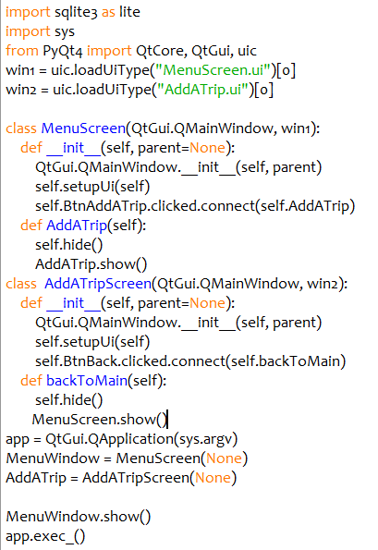
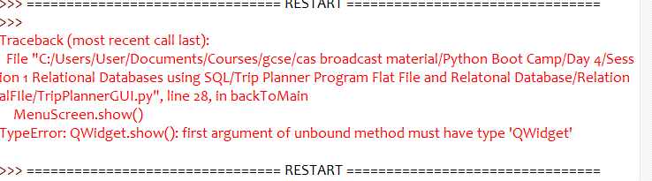
Development v0.1
This simply loads the forms and allows the user to toggle between the 2 forms that have so far set up.
There is a bug in the program in the backtoMain method.

Slide 48
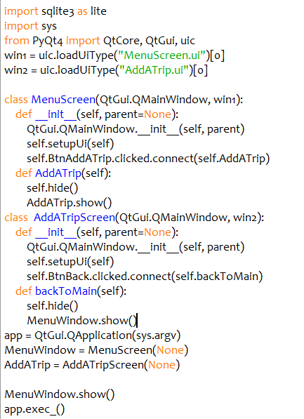
Development 0.11
I have corrected this to ensure that the user can navigate between the 2 screens

Slide 49
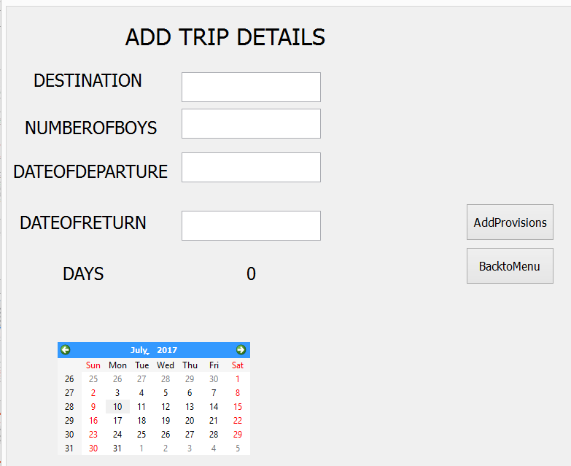
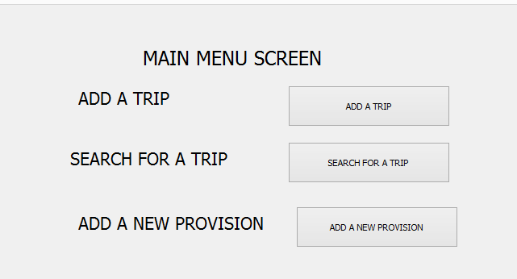
Development 0.11

Slide 50
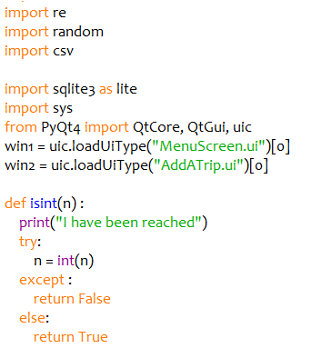
Code Development
I have added my validation procedure to check that when numerical data is entered that this is of the correct format
This program has started out as 2 screens and I need to be able to switch between the 2 windows in this case

Slide 51
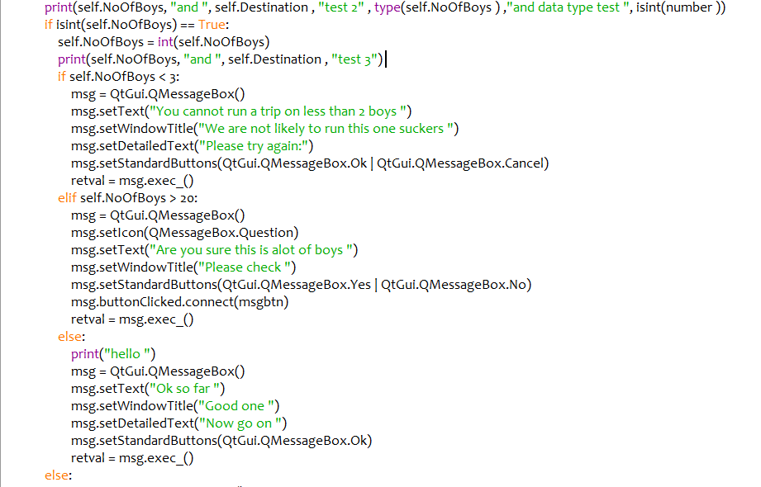
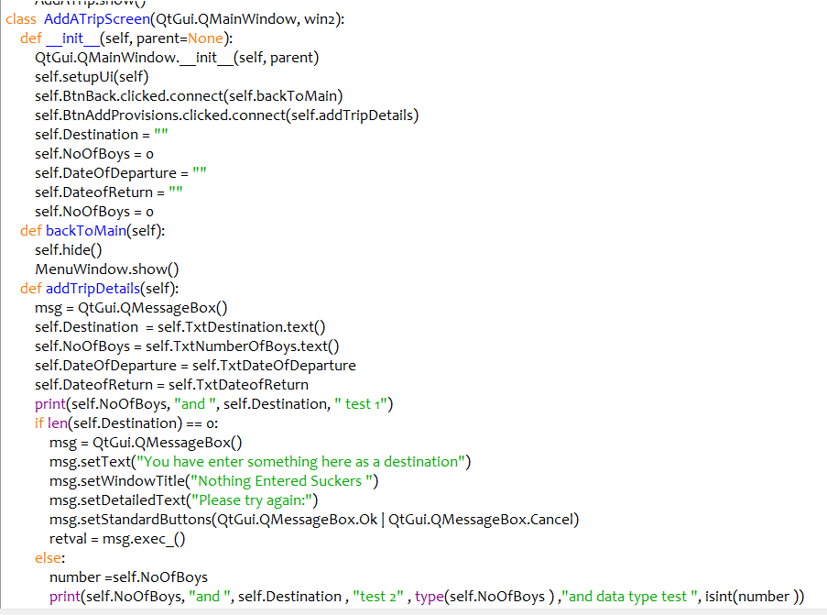
This method so far only performs the basic validation checking that text has been entered into the destination field and the number of boys is greater than 3 and less than 20

Slide 52
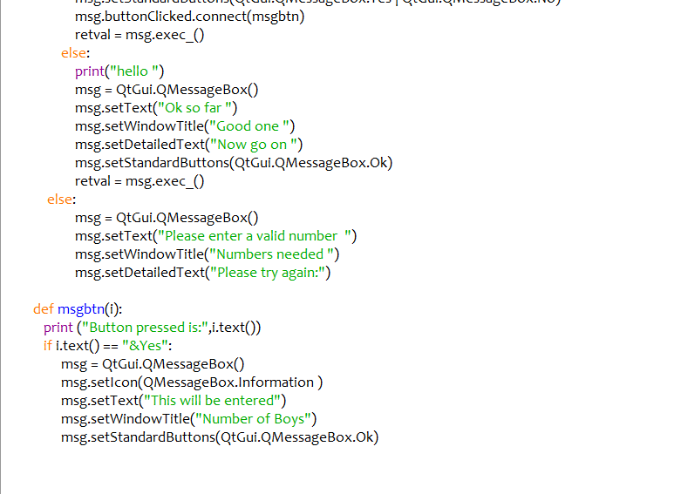
I am going to validate the entry here to ensure that the entry for numbers can be validated
This screen is going to give the user the option to add a new trip however there are several validation methods that need to be incorporated into this class before the details of any new trips can be added to the database. The program checks to see if the trip details already exist, in the database to give the user the option to re-enter the same details. It also checks the number of boys going on the trip is an integer and within the range of 1 -25 expedition trip of this type going overseas are really more than 25 boys so the program here prevents the user at the moment from adding any more than 25. The program could be modified to allow for numbers greater than this in the future. The program also asks the user for the date of departure and return and these are validated to ensure that the date of departure cannot be in the past or after the date of return. The program also calculates the number of days that the trip is for and will not allow any trip to be longer than 6 weeks.
Development Notes
For an A level project in the development section I would need to show all of the validation working as I was developing this part of the program, this would include any mistakes that were made in the development of this part of the program. To produce and get and working solution to this part of the program I had to
Work with message boxes so they displayed the correct message
Work and practice using tabs to contain more information on the screen.
I have made a number of prototypes for the development of this window
I am going to give an explanation of the code and will show this part of the program working together with some notes as to how I should approach the development of the program and what should be in a write up.

Slide 53
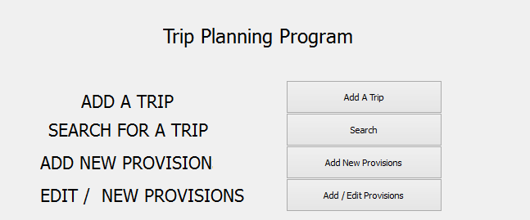
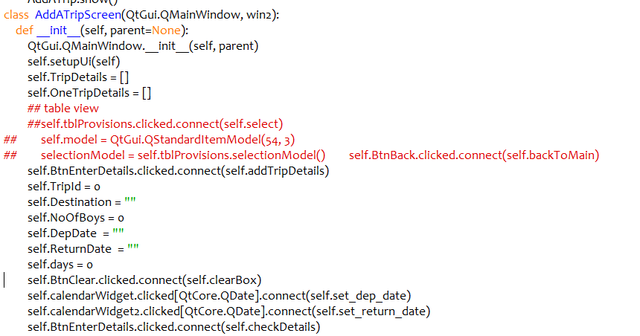
Development Notes
This part of the code always initialises the window and widgets on display
This is my first interface I am not aiming to make this look professional owing to time constraints, but adaptations care going to be made to all of the user interfaces displayed on an ongoing basis throughout my development log
At the start I also initialise all of the attributes
The def init function is the constructor method used to construct the interface for this part of the program

Slide 54
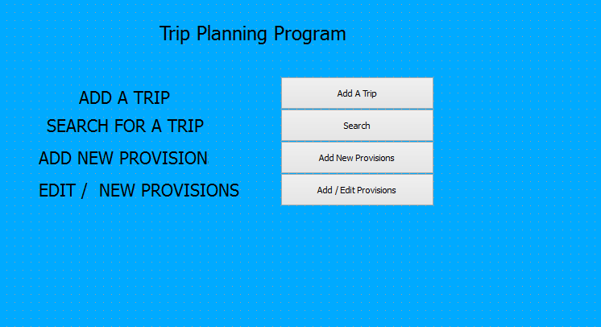
Development Notes – Main Menu
When the program initialises this is the main screens that the user will be greeted with. The first option is to add a new trip , search for a trip and then edit some of the details of that trip so that program can perform calculations The four main sections from my program are going to be to give the user the option to add a trip, search and calculate, add new provisions for a trip and to add or edit new provisions which may be needed or demanded in future visits

Slide 55
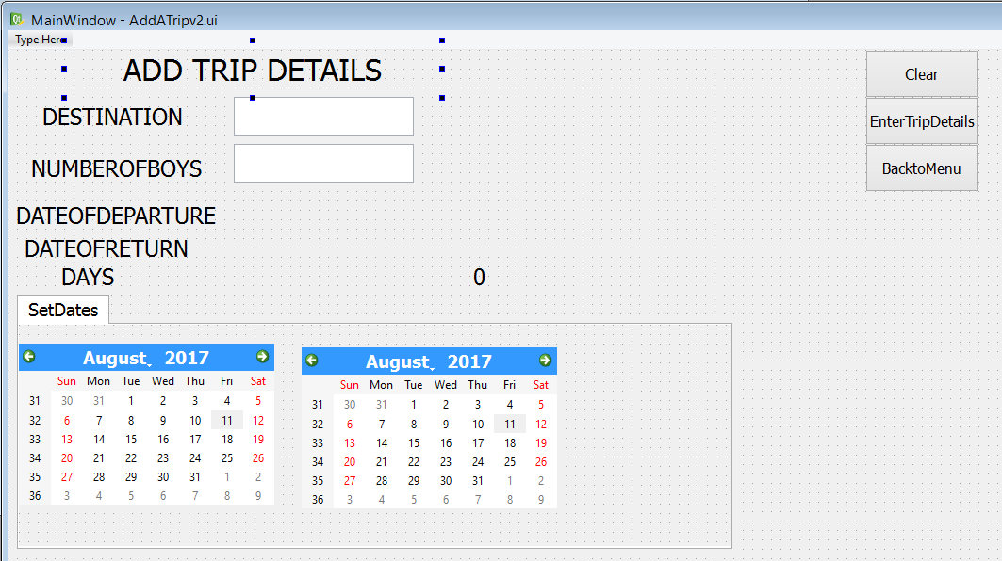
Development Add A Trip Screen
This is the screen viewable in the QT designer. Here I have added a label in the main title, I have a text box which has the destination, and the number of boys that are going to do on the trip. There are labels which display the Date of Departure and Return and a label to display the days. This is because the dates of departure and return are set by the use of the calendar widgets and then the output from the calendar widget is displayed on the labels there after. The number of days is also calculated.
I have 3 working buttons on my program which allows the user to clear options, return to the main menu or to enter the trip details this means that they are going to be written and updated to the main database.

Slide 56
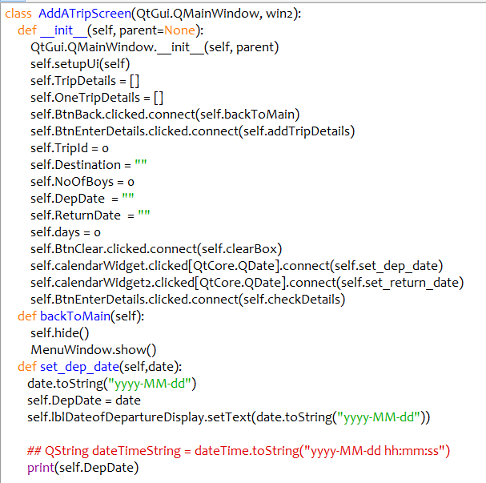
Development Add A Trip Screen
Here is the main constructor method of the add a trip class which forms the add a trip window. I am using several local attributes and methods in this class. The self.setupUi renders the widgets on the screen to connect to the main python program I am running,
The attributes I am using include
Trip Details – stores details of all trips
OneTrip Details as I am entering the details of the trip for example the main the details are stored in this list before being written to the main list and then transferred to the main database
Self.TripId – assigns a trip number to the database which is the primary key for that trip
Self.Destination refers to the country that the trip is going
Self.NoOfBoys – the integer value of the number of boys going on the trip
self.DepDate & return date – departure and return dates set by the calendar widgets. When ever a date in the calendar widget is pressed it will display the date
Self.days is the days the trip is going for and this part calculated by the program and displayed in the label.

Slide 57
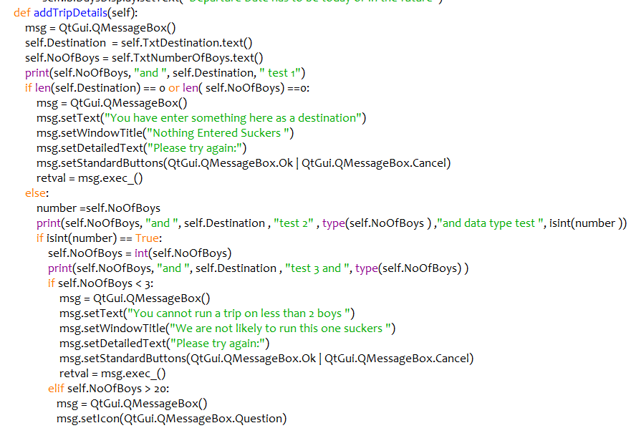
Development Add A Trip Screen
The user has to enter the destination and the number of boys going on the trip through the text box. In the code I am using now the destination is validated to ensure that some data is entered and the number of boys is validated to for data type to ensure that the entry is an integer and is greater than 2 and less than 20 boys. If the user wishes more than 20 boys to go on the trip then the program will check and validate that this is correct before allowing the data to be entered.

Slide 58
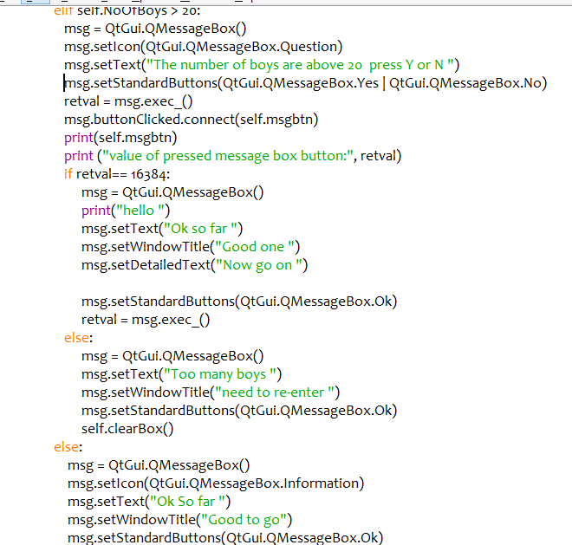
Development Add A Trip Screen
This part of the code allows the user to check they really want to plan for more than 20 boys going on a trip. The program is going to make use of PyQT message boxes to allow the user to answer the various prompts made by the system as either yes or no or to confirm options put forward for example some of the options will not give the user any option but information.

Slide 59
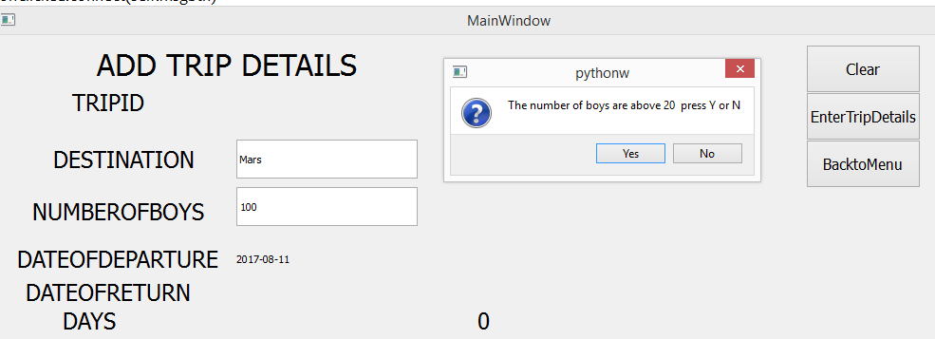
Development Add A Trip Screen
This is part of the validation message that pops up to ask if the details on the trip are correct.

Slide 60
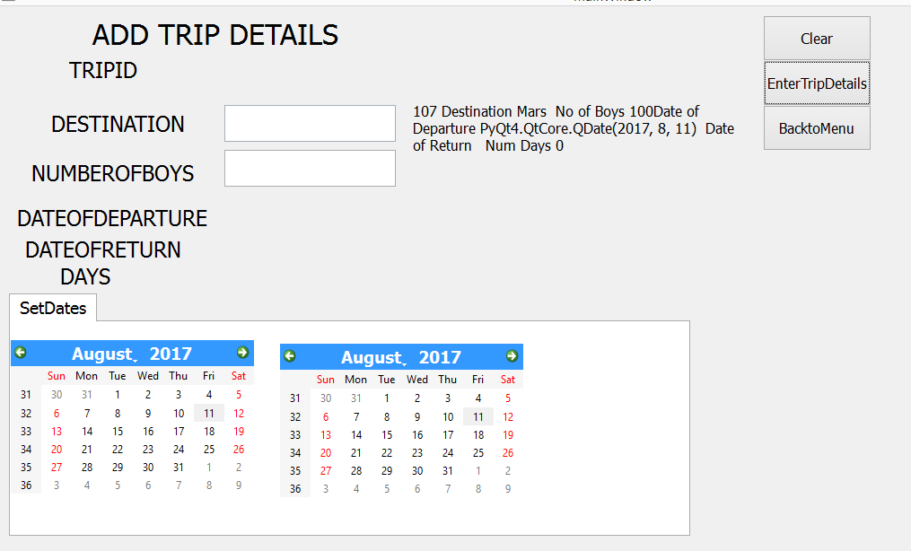
Development Add A Trip Screen
This highlights a potential number of problems with the development of the program at present firstly I can go to Mars, secondly it allowed for 100 boys even through I clicked no and it followed through allowing me to enter no dates what is going on?

Slide 61
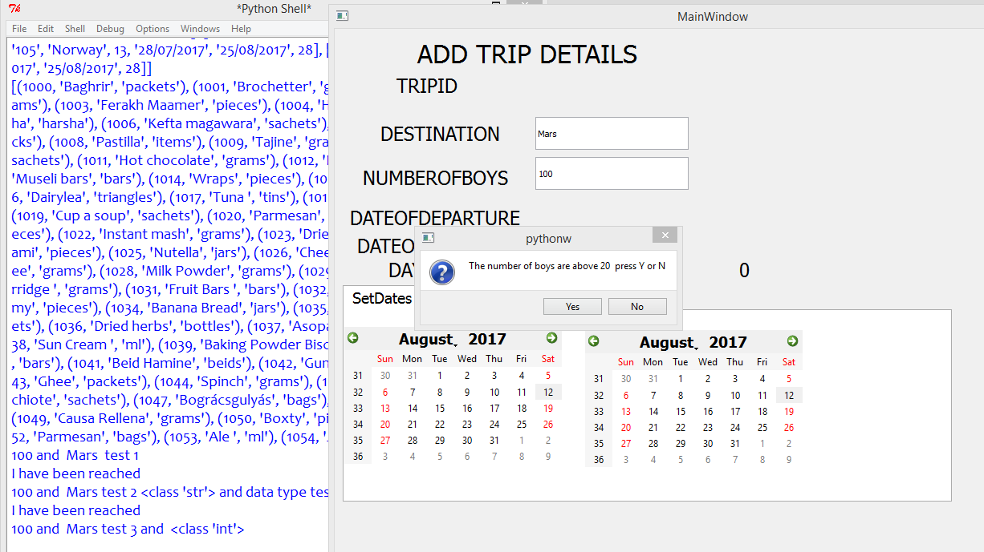
Development Add A Trip Screen
In my code as I was going along I have shown there are a number of testing points which are showing in the idle here

Slide 62
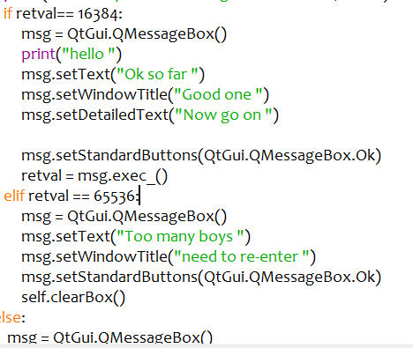
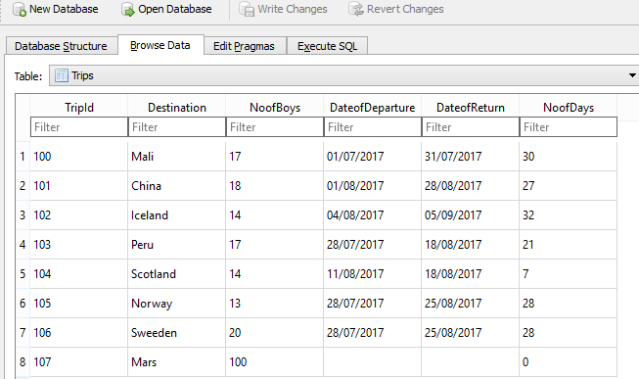
Development Add A Trip Screen
I have amended the code now so the program should cancel all of the options and ask the user to re-enter the details This also added the details to the database .

Slide 63
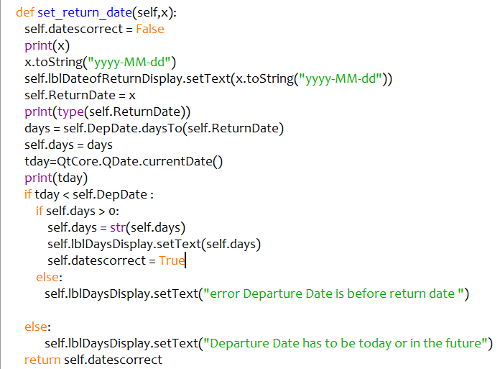
Development Add A Trip Screen
This is illustrate the type of developmental testing that needs to take place within the project documentation. As I have illustrated there are a number of problems occurred when I tried to enter data relating to trip details which I have now tried to fix. The first problem was that the button on the form was calling 2 methods, it only calls 1 method now.
I have corrected a new attribute self.datescorrect and this is set to True when the departure date is in the future and the return date is after it.
The method returns this

Slide 64
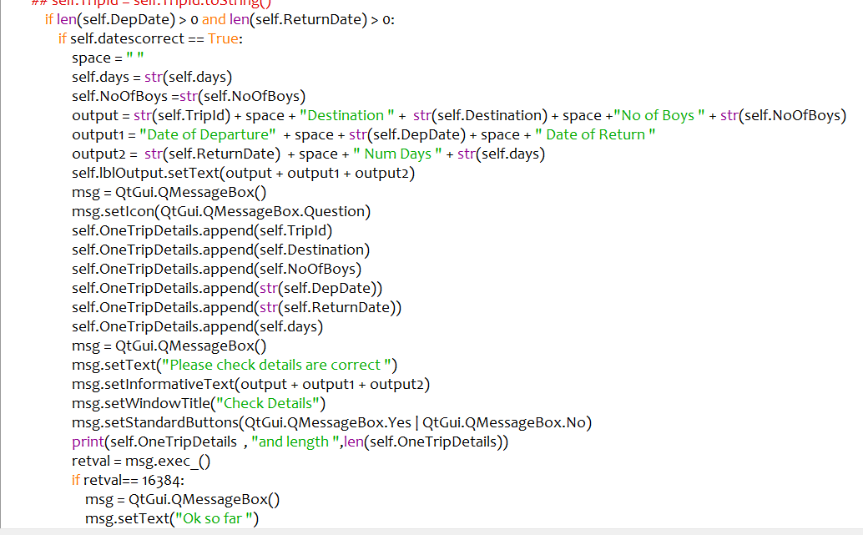
Development Add A Trip Screen
I have made some changes to the check details methods this ensures that the user has to enter data for the departure and return dates and the self.datescorrect Boolean variable has to be set to True before the data can be displayed

Slide 65
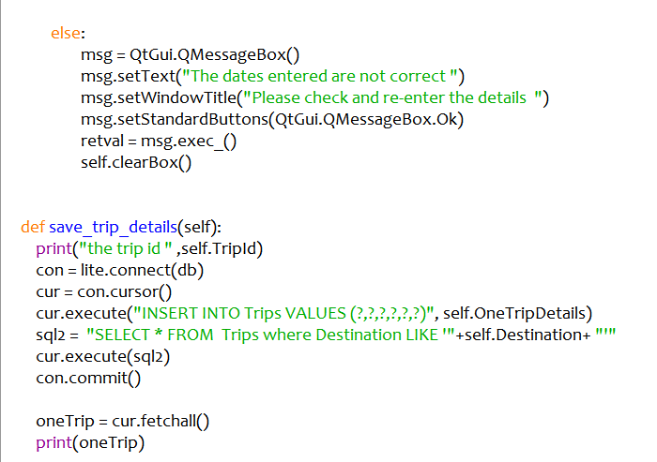
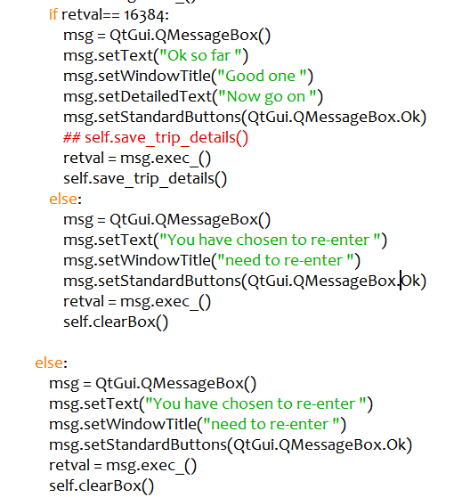
Development Add A Trip Screen
This follows on the from the validation earlier and writes the details to the database.

Slide 66
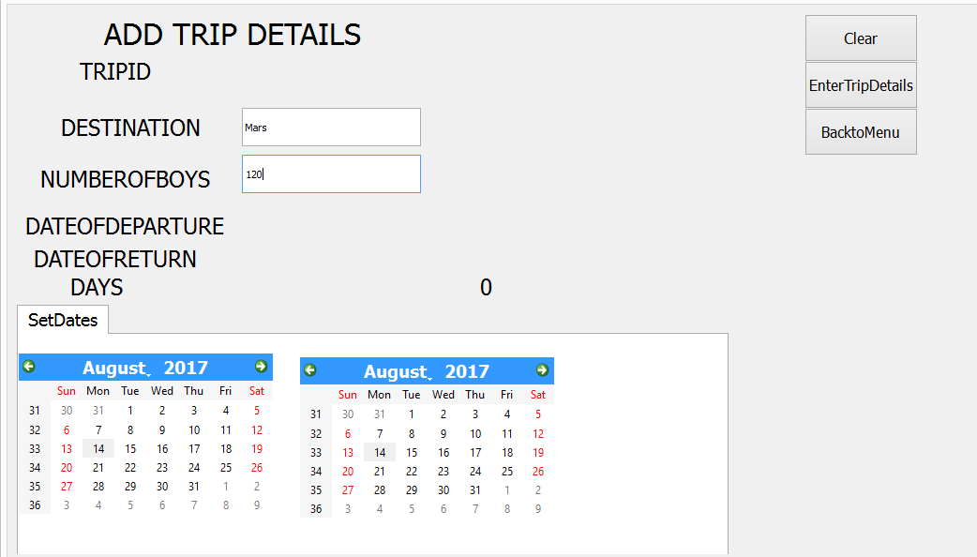
Development Add A Trip Screen Tests
I am planning on going to Mars with 120 boys and no dates fixed

Slide 67

Development Add A Trip Screen Tests
It asks me if I am sure which I can enter yes or no

Slide 68

Development Add A Trip Screen Tests
It is telling me that the dates are not correct, it clears all of the data and I have to re-enter

Slide 69

Development Add A Trip Screen Tests
This time I am off to Mars with 19 boys but the departure date is before the return date and for this reason I have to re-enter the data

Slide 70

Development Add A Trip Screen Tests
Here I am going to Mars If I can find 16 boys wishing to travel with me leaving on Tuesday 15th August and returning on Monday 4th September 2017. The output here gives the user the chance to check one last time that the details are correct before they are written back and saved

Slide 71

Development Add A Trip Screen Tests
The trip details have on this occasion been saved into the database,
Tests I would be expected to show
Destinations - what happens if I am already running a trip to the same place at the same time
The number of boys - entered as a string, a float, and a negative number and the output from the program
The departure and return dates in the past or too far in the future
The destination has to be a proper country how can I enter and get away with entering a destination like Mars?

Slide 72



Development Add A Trip Screen Tests
In order to fix this problem I have created a new method to read a list of countries which is stored in a csv file. I have created a combo box where the list of countries are going to be displayed, the output from this is then displayed in a label which has replaced the destination text box where the user was invited to anything. This is why it was possible to enter Mars as a destination. When the program is running the user is able to enter a destination from the drop down list

Slide 73



Development Add A Trip Screen Tests
I have entered North Korea as a possible location
If I enter string data for the number of boys the program prompts me to renter the data
If I try to enter data where a negative number is entered. The program will not accept data for anything less than 2

Slide 74

Development Add A Trip Screen Tests
Here I have not entered any dates for the proposed trip to North Korea, the program has returned values and I have to renter the values

Slide 75

Development Add A Trip Screen Tests
This show the program here has rejected the entry for new dates

Slide 76

Development Add A Trip Screen Tests
This shows the data being entered it ha been validated for dates, number of boys and destination

Slide 77

Development Add A Trip Screen Tests
I have made some more modifications here to the form design to include the Trip Id as well.

Slide 78

Development Add A Trip Screen Tests
This now show the trip details and data being written to the database.

Slide 79
Development Add A Trip Screen
This is an example of entering data, the program performs validation checks on a number of levels, it checks destination details through a combo box. The number of boys going on each trip is entered through a text box, this is validated so it checks that the data item entered is an integer, greater than 2 and less than 25. The program gives the user the option to accept a higher number of boys. The program also validates the dates, that the dates have been entered and the departure date cannot be entered in the past or the return date cannot itself be in the past or before the departure date.
To improve and get higher marks
The user interface needs to be made more professional, this is not an ideal interface for use and would not ideally suitable for use in the project

Slide 80

Development Load Provisions Screen
I have created this screen to give the user the option to add new provisions to the selected trips. I have used the table widget tool to create 3 tables which displays the trips stored on the database and another table which displays the provisions which are available. The other table allows the user to select options from table to be dragged into another.

Slide 81

Development Load Provisions Screen
This is the constructor method for the load new provisions screen. The method intialises the UI screen and the python program. All of the attribute. There are a number of lists I am using in the program
self.MainProvisionsList holds all of the main provisions list
self.ContainedListOneListProvs contains all of the lists provisions for one trip which is selected from the table options when this screen is intialised.
self.provId - assigned as a unique identifer for each of the provisions listed
self.provname - assigned as a variable to hold the name of the provision
self.provunits - holds the unit measurement
The program reads using an SQL command all of the contents in the provisions and trips entity
I have used table here and I have set up a table in this case which is going to consist of 3 columns when the data is displayed and an additional column where the quantities for each of the provisions can be entered

Slide 82



Development Load Provisions Screen
In the design section you will need to explain for each of the attributes used the data type, validation used, purpose and where appropriate the links between all of the attributes
You will need to state this in an Entity relationships diagram
This shows a screenshot of the organisation of the database. There are 3 entitles trips, provisions and quantities. The quantities table has 2 foreign keys the provid and tripid which are taken from the trips and provisions table

Slide 83

Development Load Provisions Screen
The last part of the constructor method here models and creates the table where the trip details are going to be displayed to the user. The table widget which is going to display the trip models has to have 6 columns created here and the data from the trips table is then displayed in the table. The event to change the trip details being viewed is activated when the user changes the option and picks another trip

Slide 84
Development Load Provisions Screen
This is where the trip details are going to appear, these are read a list and then displayed into this table widget
This available provisions are read into a provisions list and then displayed in this table widget
This gives the user the option to click on the table and move options to this table widget, at this point the quantity details are requested

Slide 85

Development Load Provisions Screen
Here I have selected the option to view the details for the trip going to Scotland. The main details are displayed on the label above and the provisions already chosen are displayed in the 3rd table along with the quantity details.

Slide 86


Development Load Provisions Screen
This is the method that loads the provisions quantities and displays them into the table widget. Here I have used modelled 2 table widgets again as well as the quantity.
This part of the code reads in the trip details and enables them to be displayed

Slide 87


Development Load Provisions Screen
Each time the user changes the trip option this selects the select trip option. The self.tripId is changed and the trip and provisions details are loaded into individual lists and displayed in IDLE. The details of the trip are displayed in label. The program then uses a select query using SQL to select provision names and units and these are displayed in the tables. If there are no provisions then the message is displayed on the label on top,

Slide 88

Development Load Provisions Screen
From here the user has the option to add or remove provisions from each of the trips and then save these back to the database

Slide 89


Development Load Provisions Screen
When the user selects one of the provisions and the add a provision button is clicked the program will add this to a temp list of provision details. The program has to each to see if the selected provision already appears in the list. If this does then a message will output on the label that this particular trip already has this provision. If found is false I have used a PyQT input box widget which is going to ask the user for the quantity. I have set 1 as a minimum and so far no maximum although this could be modified. The table is updated straightaway

Slide 90

Development Load Provisions Screen
In the say way that provisions can be added to a list then data can also be removed from the list. When the clicks the remove button the provision Id and Trip Id are used to select details from the quantities table. The data is first of all selected from the table and then I am going to run a delete query to remove the items from the quantities entity. The con.commit command writes this to the database and the self. enter_data() method displays the data.

Slide 91

Development Load Provisions Screen
This method updates the provisions for each trip in real time. Each time a change is made this is updated then this is displayed in the table

Slide 92

Development Load Provisions Screen tests
I have selected the Norway Trip, the program displays there are no provisions listed at the moment

Slide 93

Development Load Provisions Screen
I have added a provision for this for Baghir it says that this provision can be used, I have added 2000 packets of this.

Slide 94

Development Load Provisions Screen
I have tried to renter this provision but as this had already been entered the program prevents me from using the same provision again.

Slide 95

Development Load Provisions Screen
I have entered some provisions for this trip each time new provisions these are stored and displayed in order. The use of the PyQT input box is validated to prevent negative numbers from being entered.

Slide 96

Development Load Provisions Screen
I am going to enter Oats so simple which has not been entered before. I am going to use 250 packets

Slide 97


Development Load Provisions Screen
This shows the provision being added in order
After the complete transaction button is pressed the new quantities details are written to the database. However this highlights a problem in testing as the same item has been entered

Slide 98

Development Load Provisions Screen
The problem I have discovered is that the method to call the update provisions list after all of the provisions had been collated was being called twice. I have modified the code here so that the program writes all of the new provisions data into the listtowrite list which is then printed out before being written to the database. To test my modification I am going to populate the Norway trip with provisions data

Slide 99


Development Load Provisions Screen
I have selected the trip for Norway the bottom list as part of my testing shows the complete list of provisions I am taking for this trip. This shows the details being successfully written to the quantities entity in the database.

Slide 100


Development Load Provisions Screen removal
For the Norway trip I removed Baghrir the first item on the list and this shows that this was successfully removed

Slide 101
Development Load Provisions Screen
I am now able to add new trips and new provisions for each trip in the database, through the use of tables, and moving of provision details from one table to another prevents the same provision being entered twice. At the moment if the user wishes to edit the provisions details they have to removed from the database and then re-entered with a different quantity.
Improvements
Work needs to be done on the form design
Data needs to be refreshed each time so data is not lost when traversing between windows
Can provision data when selected be added and saved to the database straight away

Slide 102
Development search for a trip screen
In this screen the bulk of the processing is going to take place. The screen is going to display the recorded trips and the user is going to be able to make changes to the number of boys going on the trip or to change the dates of the trip and based on this. The program is also going to calculate the total quantities of each type of provision dependent on the unit for example grams, packets, tins, this is important to know for packing and space when the provisions need to be taken. The program will be able to graph the new quantities of each provision for each trip. The first part of this is to design an screen and interface for the user to be able to search for trip details
Quite a bit of the code is being recycled so new methods will be annotated and explained.

Slide 103

Development search for a trip screen
I am reusing code from other parts of the program. This table will display the trips stored in the database when the program is initialised. I have replicated the same screen format and used the same widgets otherwise as used in the add trip screen expect I have created and used a tab widget which allows the user to set and change the dates.

Slide 104

Development search for a trip screen
This tab will display the provisions currently recorded from the database already. I have used 2 table widgets here as one is going to show the current provisions and the other table widget is going to display the recalculated provision quantities.

Slide 105

Development search for a trip screen
This part of the program is going to display the output on a label, This will output the number of provisions unit for example tins

Slide 106

Development search for a trip screen
This is the constructor method which initialises all of the widgets on the screen and connects them to this part of the program. In this method I am essentially recycling or reusing attributes, lists and widgets which have appeared before in other sections of the program
In design I will need to give an outline of how I am going to use all of these features, including data type, scope of use, validation used. In principle all of the widgets that are used here and controls will work in the same way. There are some differences however with what in this screen can be edited and changed.

Slide 107


Development search for a trip screen
This method works in the same way as add a trip in that it loads the details of all trips and displays them in the window. All of the trip details are displayed and when each trip is clicked the provision details are then loaded into the cal provs tab

Slide 108

Development search for a trip screen
Here I have clicked on the trip for Norway the details for this trip are entered into the labels, with the trip id, destination, and dates of departure and return and calculation being displayed as labels. I have used a text box for the number of boys as this is going to be edited and changes made. Changes can also be made to the dates as well which will effect the number and the quantity of provisions required for each trip. The code to select a trip and display provisions has been recycled

Slide 109

Development search for a trip screen
The user will be able to make changes to the dates by changing the dates as they appear on the calendar widgets in the set dates tab. The dates of departure and return work in the same way as with the add a trip screen and operate with the same validation rules. The difference here is that the changes are going to be used to recalculate the quantities of each provision based on the new dates. As this method is called, the program stores as a variable the original number of boys. The provision details for each trip are loaded and stored in the contained in the self.ContainedListOneListProvs list which was initialised in the constructor method at the start. As the quantity value is the last column this has to be converted to a float.
I have created a new local variable new quantity which multiplies the original quantity by the new calculated number of days and divides this by the original. It does this for each and every provision for that trip. The data is then rounded and cast as string to be displayed in the table. The data is then viewed in the calprovs tab.

Slide 110

Development search for a trip screen
I have changed the dates of the Norway trip here. This had to be for a time in the future so the trip has been extended by 1 day. The date of departure is 16th August returning 14th September 2017..

Slide 111

Development search for a trip screen
When the calProvs tab is selected, the new quantities are viewable. The same validation works these features have already been tested.

Slide 112


Development search for a trip screen
This method give the user the option to change the number of boys going on the trip. Here I have made use of PyQT’s input box. The validation on this is built in as the program will only accept integer input between 1 and 25. As soon as I start typing in the text box the input box appears and requests amended input. The user has the option to confirm this choice or not.

Slide 113

Development search for a trip screen
This is where the main processing of the provisions takes place. I have also included in this method a calculation which is going to work the quantities of the units hat the provisions come in. This may be relevant for when provisions are packed. When the provisions are re-calculated it uses the same formula as when the dates changes. The program will calculate multiply the quantity by the new number of boys and divide this by the original number. The new output is then rounded and cast as string before being displayed in the table widget.

Slide 114

Development search for a trip screen
I have changed the number of boys here to 16 and the new provisions quantities are then displayed. This is an example of a query as it is not our intention to write this back to the database.

Slide 115



Development search for a trip screen
This part of the method is displaying the total of each of the units that will need to be packed before departure on the trips.
The output for this is displayed in the tabulated section marked as show output

Slide 116

Development search for a trip screen
Here this method gives the user the option to update this by writing these details back to the database. I have used PyQT input box and items which appear in the list are simply yes or no. If yes is selected the methods showme and graphme are called.

Slide 117



Development search for a trip screen
The user here is asked if they want to run the query for updating the number of boys and then to confirm whether this new data is going to written back to the database.
Showme then prints out the provisions needed for the trip
The graphme methos takes 2 columns from the selfContainedListOneListProvs list and plots them. I have substituted the numbers in counter with the values in column 1 which are the individual provision names. I have used the matplotlib library function to construct the graphs

Slide 118

Development search for a trip screen
I am going to enter 18 boys as the new number of boys to go to Norway

Slide 119

Development search for a trip screen
This now shows the recalculated provision based on the new number of boys being entered.

Slide 120

Development search for a trip screen
This show the output produced from the query.

Slide 121


Development search for a trip screen
This shows the printed output that has produced
In order to make the changes in the database I have used an update query, so the quantities table is updated where the tripid and provid in the quantities are the same as the provid and trip id variables. The number of boys in the trips table is also updated.

Slide 122

Development search for a trip screen
This screenshot shows the totals for the new quantities have been saved and written back to the database file

Slide 123
Development search for a trip screen
The program allows the user to make two edited changes, one to change the dates and the other to change the number of boys that can go on the trip. The changes to the dates are viewable at the moment as a query only and these are displayed. The same validation routines apply as before, namely dates for departure or return cannot be set in the past, and the date for return must be after date for departure. The changes to the number of boys is validated so that this is a number greater than 2 and less than 25. The user here has the option to save these changes to the database and a graph of new provisions details also created.
Possible improvements
Use of User Interface
Give the user the option to update and write back changes for dates
The code I have used here is really quite long and cumbersome and there are a number of techniques I could make use of getters and setters so that methods and their attributes can be shared between classes

Slide 124

Development Add A Provisions Screen
This screen is developed to allow the user to add/ edit and change provisions which are held in the provisions entity in our database. This is an independent module and allows the user to edit, add or delete new provisions without having to edit trips
This is where the provisions details are going to be appear as they will appear in a 3 column table. When adding or editing provisions the entry will be made through the text boxes highlighted.

Slide 125



Development Add A Provisions Screen
This is showing the constructor method I am using which has used code from other screen set ups. The program initialises the widgets and the provisions data is displayed in the table widget

Slide 126

Development Add A Provisions Screen
When the add button is activated this program will run a method, the provision name is checked against all of the provisions and if this is found it will produce an alert message. Otherwise the new provision is assigned a new ProvId code and the new provision names and units are added to the provisions entity

Slide 127

Development Add A Provisions Screen Edit
This method gives the user the option to edit the provision details. When the provisions are displayed the user has to enter the provid and enter what they need to be amended to in the relevant text boxes and this data is then updated.

Slide 128



Development Add A Provisions Screen Delete
This method allows the user to remove a provision from the database if this is now longer required . When the relevant column is clicked the program output the relevant provision id. In this case 1000. When the delete button is clicked the program selects all of the instances where the relevant ProvId is located this will include all of those entries in the quantities entity as well las the entries in the provisions entity. If the provision is going to be removed then the program must ensure that all instances and records pertaining to the provision are deleted. I have used select here I would simply replace select with delete in my SQL query and the entry would be deleted from the database.

Slide 129

Development Add A Provisions Screen Delete
Here I have clicked on 1002 Couscous and the program highlights here all instance relating to provision number 1002 and these would be deleted if the delete was substituted for select thus enforcing referential integrity of our database

Slide 130
Testing and Evaulation Testing to inform evaluation
(a) Provide annotated evidence of testing the solution of robustness at the end of the development process. Once the program is complete, you test it all again!
Expect this time this is functional testing and needs to relate to the test plan in the design section, this starts from logging on or signing up to producing calculations for the program itself. Each test needs a complete commentary and here you also to mention all of the success criteria that you have used.
At the start of the project you did some research and agreed you that the program would be able to perform certain tasks called objectives. In this section now that the program has been completed you have to show how these were met. You have to show these with test data
Logon
It is essential that your program has at least 60 objectives. This should also include the ability for a user to log on and validate their user name and password. Each teacher could have a log on and be assigned to a particular trip and can view and edit data relating to that trip but no others. There should also be an administration option where one user has admin.
I have not done a user log on account but have a tutorial relating to this.
Objectives here for a log on could include
Usernames could be an email, and therefore would have to have the characteristics of an email address.
Passwords have to be a certain length with a number of upper, lower and numerical characters. Can the password be encrypted?

Slide 131
Testing and Evaulation Testing to inform evaluation
Addition of new Trips and Provisions
Enter new trips from a pre-specified list of countries loaded into a list
Allow the user to enter the number of boys going on the trip, must be an integer, larger than 3 and less than 25. The user is given the option of allowing more boys to go on the trip
Allow the user to enter the dates of departure and return. The dates entered cannot be in the past, and the date of return must be after the date of departure.
The program calculates the number of days that the trip is running based on subtracting the Date of return from the date of departure
This data is stored in a database file.
The program should allow the user to enter provisions for the stated trip. The user should be able to enter the quantity required and this has to be greater than 0 and an integer or a float / real number.
The program should alert the user if there is trip going to the same place in the same time frame
Addition of new provisions
Enter new provisions to be added including their provision id, provision name and units of measurement
Allow the user to edit these provisions and change the units or spelling
Allow the user to delete the provisions if these are no longer required and these are deleted across the database entire

Slide 132
Testing and Evaulation Testing to inform evaluation
Search for Trips and provisions
The program should display the details of all trips planned including trip id, destination, number of boys as well as dates of departure and return as well as the days that the trip is running
When the trip is selected the program should display the provisions selected for the trip including provision id, provision name, units and quantities selected
The program should allow the dates of departure and return to be amended and should recalculate the quantity of provisions required for the trip
The program should allow the user to modify the number of boys going on the trip this has to be an integer, greater than 0 and less than 25. The program should recalculate the quantity of provisions required for the trip based on the new number of boys going on the trip
The program should calculate the total number of units for each provision for example the number of tins, jars, sachets, pieces, grams, etc required
Any changes made to the number of boys or dates should be written to the database
The program should produce printed output which gives a break down of provisions required for each trip
The program should be able to graph the quantities of provisions required with the provision name appearing on the x axis

Slide 133
Testing and Evaulation Testing to inform evaluation
(b) Provide annotated evidence of usability testing (user feedback). Compare the design you made for the output/input and how it actually came out, would you go back and change some of the design given more time?
We have used some of our basic objectives where you able to extend these ideas and include some of the modelling ideas mentioned earlier in the presentation. What input has there been from the end user? Here it is important to have 3rd party evaluations of the program, namely that they look over your program and test it

Slide 134
Testing and Evaulation Success of the solution
(a) Use the test evidence from the development and post development process to evaluate the solution against the success criteria from the analysis. Copy and paste your success criteria table from before and evaluate the success of every test by looking at the criteria. Here we should see customer/users' involvement here, e.g. "that font is too small in smaller screens, so fail the success criteria of the program being able to run on all the screen sizes available commercially"
b) Used the test evidence to cross reference with the success criteria to evaluate the solution explain how the evidence shows that the criteria has been fully, partially or not met in each case. Refer to the screenshot numbers when evaluating.
c) Provided comments on how any issues with partially or unmet usability features could be addressed in further development. Failed tests - how would you fix it in the future? E.g. use dictionaries instead of lists, use tabs instead of multiple windows, use combo boxes instead of text boxes, etc.

Slide 135
Testing and Evaulation Maintenance and development
(a) Discuss the maintainability of the solution. Think of the possible ways the program could be changed (new features added, more data to deal with), what could present a problem? Do you know the Big O complexity of your algorithms? Can you estimate them?
b) Considered maintenance issues and limitations of the solution
Described how the program could be developed to deal with limitations of potential improvements / changes. What would it take to port this program to mobile or web? Or to a different programming language? Or to Siri-like interface?
.
(c) Discuss potential further development of the solution. Relating to the partial successes, what would you change if you had more time/skill Provided comments on how any partially or unmet criteria could be addressed in further development.
There is a well developed line of reasoning which is clear and logically structured. The information presented is relevant and substantiated. Used specialist terminology from the textbook in your analysis

Slide 136
General Notes on the presentation of work
In Analysis, there has to be a through investigation into similar or existing solutions, when producing system requirements these need to be justified.
In the development section it is important that you show the processes of development and there has to be testing carried out as you are developing this
Evaulation and testing – There needs to be screenshots with documentary evidence showing the tests and comments against how they met the success criteria and objectives

Slide 137
Guidance for Analysis
Analysis - 10 marks
Spec - Points | What it means / Ideas?
Problem Identification * Describe and justify the features that make the problem solvable by computational methods and amenable to a computational approach. | What is the advantage of solving your problem using a computer program? You should compare to other methods such as paper-based and think about input / process / output / storage / sharing / backup / engagement
Stakeholders * Identified and describe your stakeholders (audience) and described them, explaining how they’ll use the solution and why it is appropriate to their needs | Give details about any groups of people (or actual people) that have a stake in how your program will be used. You should explain who they are, ask them questions in an interview or questionnaire, and analyse the results
Research the problem * Research in depth existing solutions to similar problems & identify your approach based on these. * Describe the essential features of a computational solution-explain these choices. Identify & explained and limitations of the proposed solution | Research and give actual sources of similar programs / apps / books avaiable. Compare what they do well and not so well, use print screens to help explain your reasoning.
Specify the proposed solution * Identified the hardware and software requirements of the solution. * Identify and justify a list of measurable success criteria, explaining your choices. | Must be measurable points such as - 1. When program starts the log-in screen appears. 1.1 When the log-in button is clicked the next screen appears 1.2 A suitable error message is displayed and there is no log-in for the following situations: 1.2.1 A zero length string has been entered 1.2.2 The log-in details don't match any of those in the file 1.2.3 If the log-in file cannot be found

Slide 138
Guidance for Design
Decompose the problem * Break down the problem into smaller parts suitable for computational solutions justifying any decisions made. | Use diagrams, such as Top Down Design, OOP Class diagrams.
Describe the solution * Explain and justify the structure of the solution. * Describe the parts of the solution using algorithms justifying how these algorithms form a complete solution to the problem. * Describe usability features to be included in the solution. * Identify key variables / data structures / classes justifying choices and any necessary validation | - Justify each of these smaller chunks. - Write pseudocode for each smaller chunk and explain what it does. How does it form a complete solution? - Validation / Form Designs - Data structures / Files / Arrays needed
Describe the approach to testing * Identify the test data to be used during the iterative development and post development phases and justify the choice of this test data | Write a test plan, it should test every point from your success criterial

Slide 139
Guidance for Development
Spec points | Ideas
Iterative development process * Provide annotated evidence of each stage of the iterative development process justifying any decision made * Provide annotated evidence of prototype solutions justifying any decision made. | * State the iteration number and the module that you will solve * Show evidence of your code in stages of development - explain and justify your coding decisions * Comment and annotate code fully * Use sensible identifier naming and thorough validation * re-visit the design section - are you still happy? Do you need to make changes or contact end user? * Amend Design section (keep both!) before implementing next module
Testing to inform development Provide annotated evidence for testing at each stage justifying the reason for the test. Provide annotated evidence of any remedial actions taken justifying the decision made. | * At key points DURING DEVELOPMENT review and test your code - failed tests are important - what will you do? * Test for valid / extreme / invalid data * Annotate and justify each test

Slide 140
Guidance for Testing and Evaulation
Testing to inform evaluation * Provide annotated evidence of testing the solution of robustness at the end of the development process. * Provide annotated evidence of usability testing | * use Black Box testing to prove Functional testing * Get the end user to support your testing and annotate evidence of their findings * Ensure that you have failed tests and explain what has happened, were they missed during developemnt? With more times could you solve them?
Success of solution Use the test evidence from the development and post development process to evaluate the solution against the success criteria from the analysis. | Evaluate the solution against the success criteria referring to your testing evidence (during development and post-development)
Describe the final product Provide annotated evidence of the usability features from the design, commenting on their effectiveness
Maintenance and development * Discuss the maintainability of the solution. * Discuss potential further development of the solution. | * What maintenance may be required in the future and by who? * If you had more time / money / experience what further development could you do in the future?

Slide 141

Mark Scheme Analysis

Slide 142

Mark Scheme Design

Slide 143

Mark Scheme Development 15 marks

Slide 144

Mark Scheme Development Testing 10 marks

Slide 145

Mark Scheme Testing and Evaulation

Slide 146

Mark Scheme Testing and Evaulation

